Slide 1
Chemistry – Week of April 20 Lesson #1
Today’s Objective –
  Moles and Chemical formulas
  Stoichiometry
Agenda
  Moles and Chemical formulas
  Moles and Reactions
Assignment:
  Stoichiometry Worksheet

Slide 2
Chemical Formulas and Conversion Factors
Because the chemical formula indicates the number and ratio of atoms in a compound, conversion factors can be written to convert between moles of atoms and moles of compounds.
Ex: 1 mole CO₂ contains 1 mole of C and 2 mole of O
Ex: How many moles of O are present in 3.25 mol of H₃PO₄?

Slide 3
Gram – mole –number of items problems
Grams of X
Not Here!!
Grams of Y
Molar mass
Molar mass
Liters of X
22.4
Moles of X
Chemical formula
Moles of Y
22.4
Liters of X
Macroscopic scale
6.022x10²³
6.022x10²³
Number of X
Chemical formula
Number of Y
Atomic scale

Slide 4
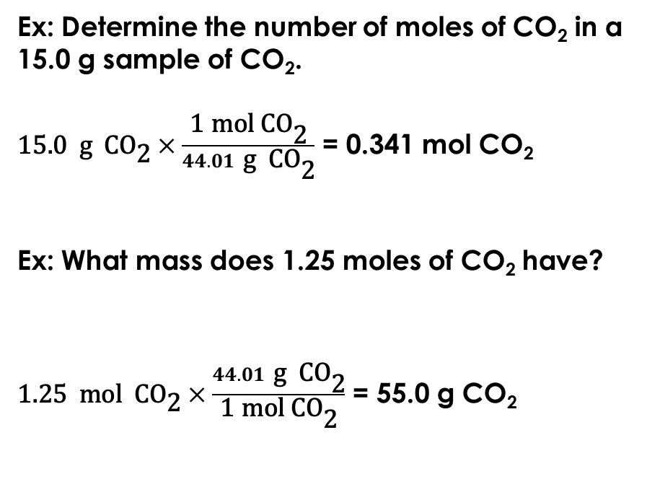
Gram – mole problems using the chemical formula
Ex: Determine the number of moles of CO₂ in a 15.0 g sample of CO₂.
$\text{15.0 }\text{g} \text{C}{\text{O}}_{\text{2}}×\frac{\text{1 }\text{mol} \text{C}{\text{O}}_{\text{2}}}{44.01 \text{g} \text{C}{\text{O}}_{\text{2}}}$ = 0.341 mol CO₂
Ex: What mass does 1.25 moles of CO₂ have?
$\text{1.25} \text{mol} \text{C}{\text{O}}_{\text{2}}×\frac{44.01 \text{g} \text{C}{\text{O}}_{\text{2}}}{\text{1 }\text{mol} \text{C}{\text{O}}_{\text{2}}}$ = 55.0 g CO₂
Grams of CO₂
Molar mass
44.01 g/mol
Moles of CO₂

Slide 5
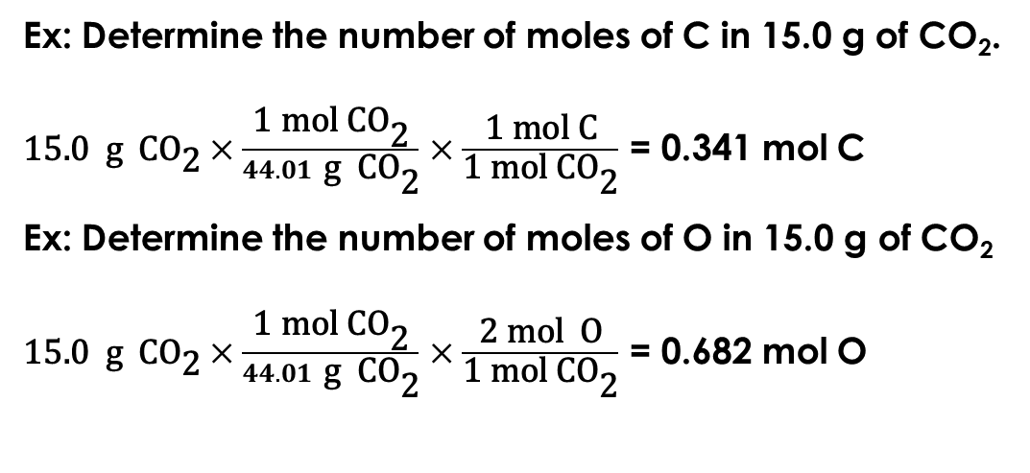
Gram – mole problems using the chemical formula
Ex: Determine the number of moles of C in 15.0 g of CO₂.
$\text{15.0 }\text{g} \text{C}{\text{O}}_{\text{2}}×\frac{\text{1 }\text{mol} \text{C}{\text{O}}_{\text{2}}}{44.01 \text{g} \text{C}{\text{O}}_{\text{2}}}$ $×\frac{\text{1 }\text{mol} \text{C}}{\text{1 }\text{mol} \text{C}{\text{O}}_{\text{2}}}$ = 0.341 mol C
Ex: Determine the number of moles of O in 15.0 g of CO₂
$\text{15.0 }\text{g} \text{C}{\text{O}}_{\text{2}}×\frac{\text{1 }\text{mol} \text{C}{\text{O}}_{\text{2}}}{44.01 \text{g} \text{C}{\text{O}}_{\text{2}}}$ $×\frac{\text{2} \text{mol} \text{O}}{\text{1 }\text{mol} \text{C}{\text{O}}_{\text{2}}}$ = 0.682 mol O
Grams of CO₂
Molar mass
44.01 g/mol
Moles of CO₂
Chemical formula
Moles of C
or O

Slide 6
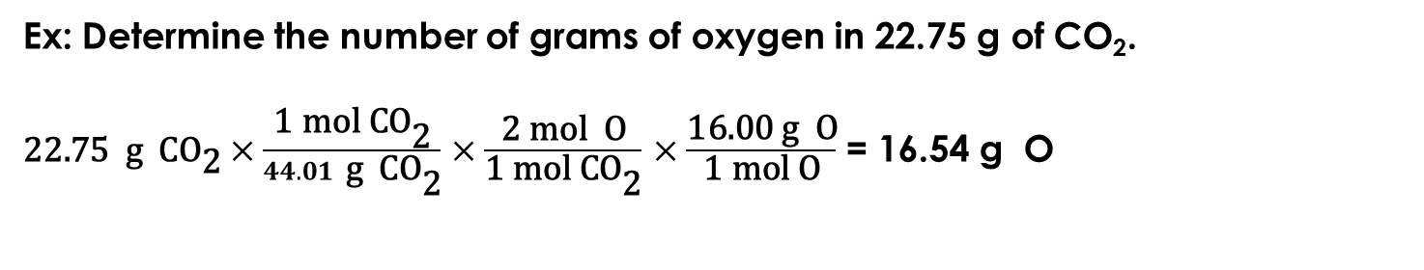
Gram – mole problems using the chemical formula
Ex: Determine the number of grams of oxygen in 22.75 g of CO₂.
$\text{22.75} \text{g} \text{C}{\text{O}}_{\text{2}}×\frac{\text{1 }\text{mol} \text{C}{\text{O}}_{\text{2}}}{44.01 \text{g} \text{C}{\text{O}}_{\text{2}}}$ $×\frac{\text{2} \text{mol} \text{O}}{\text{1 }\text{mol} \text{C}{\text{O}}_{\text{2}}}$ $×\frac{\text{16.00 }\text{g} \text{O}}{\text{1 }\text{mol} \text{O}}$ = 16.54 g O
Grams of CO₂
Grams of O
Molar mass
44.01 g/mol
Molar mass
16.00 g/mol
Moles of CO₂
Chemical formula
Moles of O

Slide 7
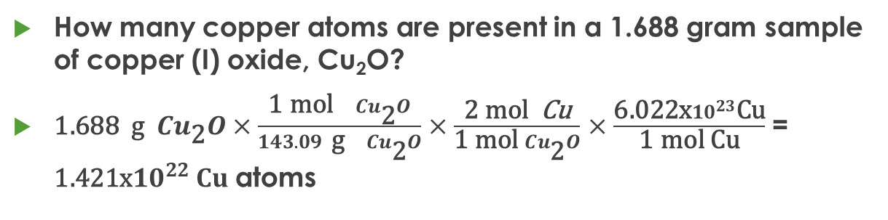
Gram – mole – number problems using a chemical formula
Grams of X
How many copper atoms are present in a 1.688 gram sample of copper (I) oxide, Cu₂O?
$\text{1.688} \text{g} {Cu}_{\text{2}}O×\frac{\text{1 }\text{mol}{ Cu}_{\text{2}}O}{143.09 \text{g}{ Cu}_{\text{2}}O}$ $×\frac{\text{2} \text{mol} \text{Cu}}{\text{1 }\text{mol} {Cu}_{\text{2}}O}$ $×\frac{\text{6.022}\text{x}{10}^{23}\text{Cu}}{\text{1 }\text{mol} \text{Cu}}$ = $\text{1}\text{.421}\text{x}{10}^{22} Cu$ atoms
Molar mass
143.09 g/mol
Moles of X
Chemical formula
Moles of Y
Macroscopic scale
6.022x10²³
6.022x10²³
Atomic scale
Number of X
Number of Y

Slide 8
Stoichiometry
Stoichiometry is the study of the quantitative relationships present within a balanced chemical reaction
  A balanced reaction has the same number of atoms of each element on both sides to achieve conservation of mass.
  The coefficients tell how many formula units are required or produced to achieve this.
  Because a mole is simply a way to count items, the coefficients of a balanced reaction also relate the number of moles of reactants and products.

Slide 9
Mole Ratios
Consider 1 Zn (s) + 2 HCl (aq)→ 1 ZnCl₂ (aq) + 1 H₂ (g)
Several mole ratios are possible. These are just some:

Slide 10
Stoichiometry Problem Solving
Same problem solving. Only difference is you need a balanced reaction first. It may be given or you may need to predict products and/or balance.
Ex: 1 Zn (s) + 2 HCl (aq)→ 1 ZnCl₂ (aq) + 1 H₂ (g)
Ex: How many moles of hydrogen are formed from 3.50 mole of hydrochloric acid?

Slide 11
Gram – mole –number of items problems
Grams of X
Not Here!!
Grams of Y
Molar mass
Molar mass
Liters of X
22.4
Moles of X
Chemical formula
Moles of Y
22.4
Liters of X
Macroscopic scale
6.022x10²³
6.022x10²³
Number of X
Chemical formula
Number of Y
Atomic scale

Slide 12
Stoichiometry
Grams of X
Not Here!!
Grams of Y
Molar mass
Molar mass
Liters of X
22.4
Moles of X
Balanced Reaction
Moles of Y
22.4
Liters of X
Macroscopic scale
6.022x10²³
6.022x10²³
Number of X
Balanced Reaction
Number of Y
Atomic scale

Slide 13
Stoichiometry g-m-m-g Problem
How many grams of lithium hydroxide are produced when 25.0 g of lithium is dissolved in water?
2 Li + 2 H₂O → 2 LiOH + 1 H₂
25.0 g g ?
gram → mole → mole → gram

Slide 14
Stoichiometry g-m-m Problem
How many moles of lithium are needed to produce 25.0 g of lithium hydroxide dissolved in water?
2 Li + 2 H₂O → 2 LiOH + 1 H₂
mol? 25.0 g
gram → mole → mole → gram

Slide 15
Stoichiometry
How many grams of potassium chlorate do you need to decompose to produce 3.75 moles of oxygen gas?
2 KClO₃ → 2 KCl + 3 O₂
g? 3.75 mol
mole → mole → gram

Slide 16
Exit Slip - Homework
Exit Slip: How many grams of silver are present in 23.5 g of silver nitrate?
Answer: 14.9 g Ag
What’s Due? (Pending assignments to complete.)
  Stoichiometry worksheet

